Slide 1
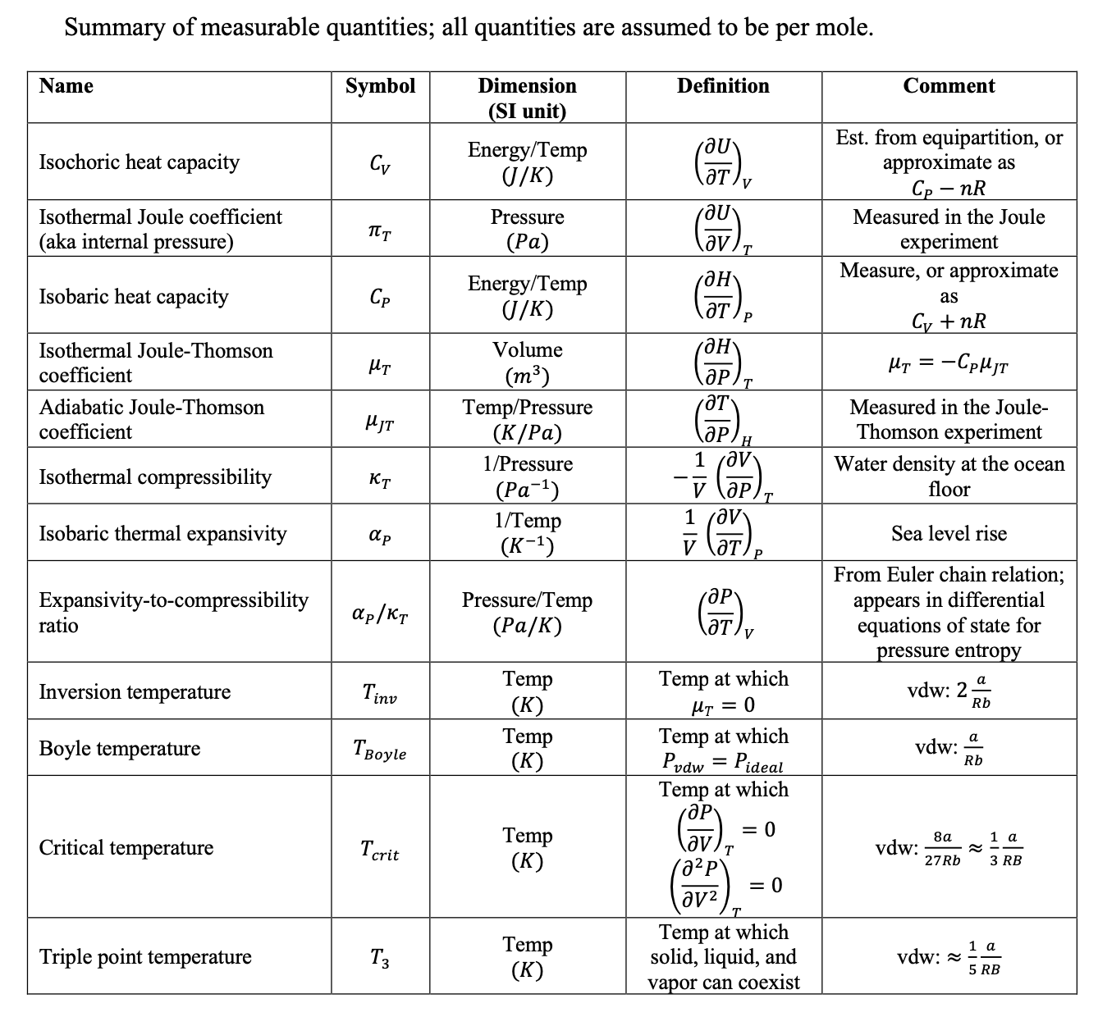
Check-in on measurable quantities

Slide 2
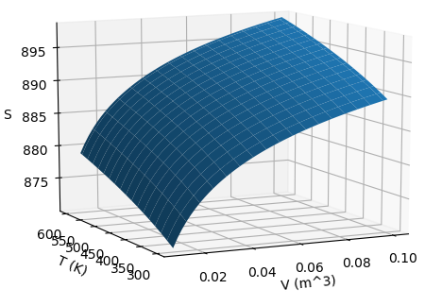


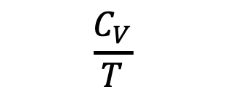

Last time: introduced the Thermodynamic Definition of Entropy and the state function $S(T,V)$
$$\frac{dq_{rev}}{T}=dS$$
Thermodynamic definition of entropy
$$S(T,V)$$
$$\frac{C_{V}}{T}$$
$$\frac{α_{P}}{κ_{T}}$$

Slide 3
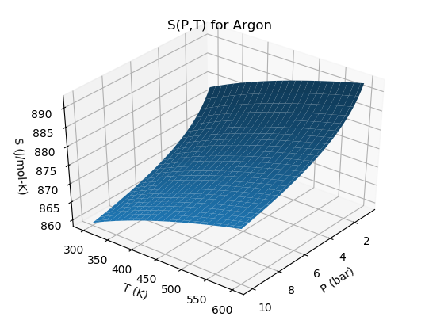
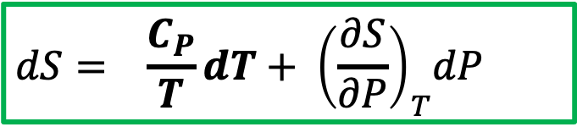
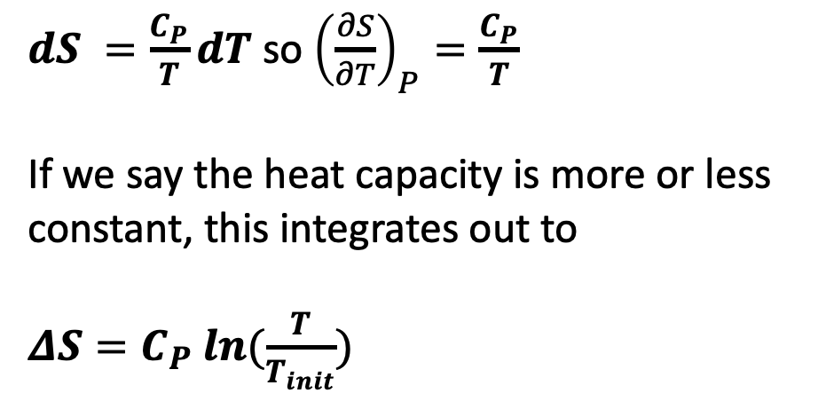


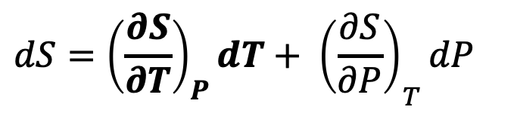
Now switching to $S(T,P)$: isobaric heating
$dS =\frac{C_{P}}{T}dT$ so ${\left(\frac{∂S}{∂T}\right)}_{P}=\frac{C_{P}}{T}$
If we say the heat capacity is more or less constant, this integrates out to
$ΔS=C_{P} ln⁡(\frac{T}{T_{init}})$
$${\left(\frac{∂S}{∂P}\right)}_{T}$$
$${\left(\frac{∂S}{∂T}\right)}_{P}$$
$$dS={{\left(\frac{∂S}{∂T}\right)}_{P}dT+ \left(\frac{∂S}{∂P}\right)}_{T}dP$$
You should probably commit this to memory too
$$dS={ \frac{C_{P}}{T}dT+ \left(\frac{∂S}{∂P}\right)}_{T}dP$$

Slide 4
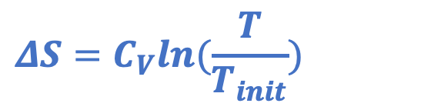
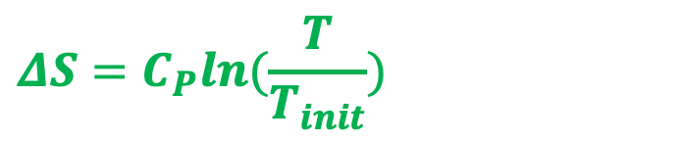
Why isobaric heating increases entropy more than isochoric heating
Isobaric heating
$$ΔS=C_{P}ln⁡(\frac{T}{T_{init}})$$
isobaric
Heating at constant pressure => more in thermal and positional entropy
S
$$ΔS=C_{V}ln⁡(\frac{T}{T_{init}})$$
isochoric
Isochoric heating
T
Heating at constant volume, so increase in thermal entropy only

Slide 5
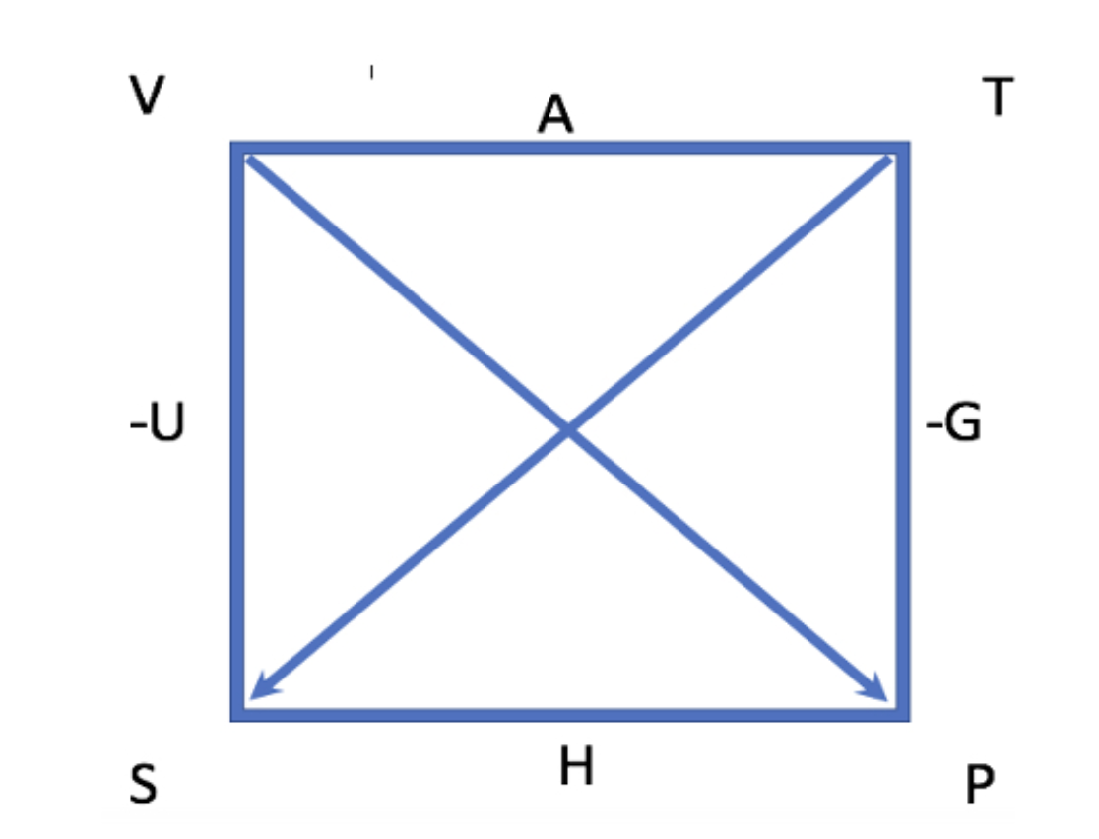
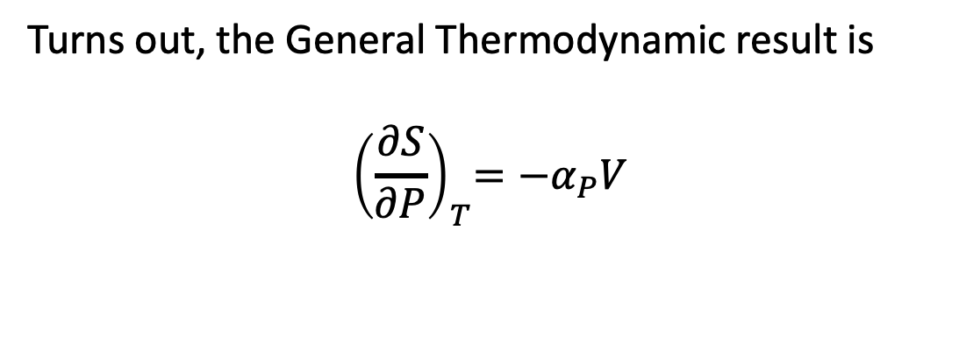
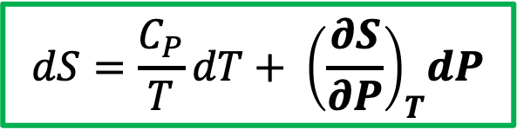
The other dimension of $S(T,P)$: isothermal changes in pressure
Turns out, the General Thermodynamic result is
$${ \left(\frac{∂S}{∂P}\right)}_{T}=−α_{P}V$$
$${\left(\frac{∂S}{∂P}\right)}_{T}$$
$${\left(\frac{∂S}{∂T}\right)}_{P}$$
(Also a Maxwell equation thing ... get to this later this week)
$$dS=\frac{C_{P}}{T}dT+{ \left(\frac{∂S}{∂P}\right)}_{T}dP$$

Slide 6
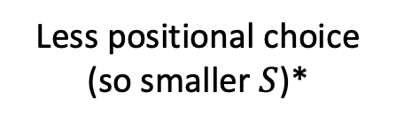
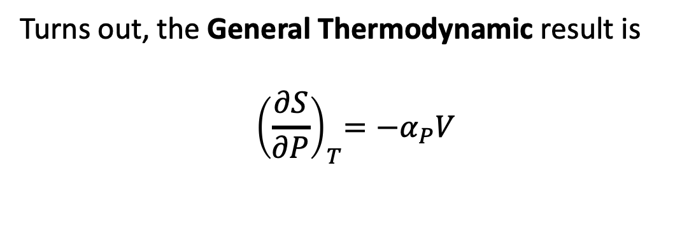
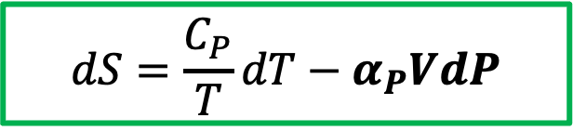
The other dimension of $S(T,P)$: isothermal changes in pressure
Turns out, the General Thermodynamic result is
$${ \left(\frac{∂S}{∂P}\right)}_{T}=−α_{P}V$$
$${\left(\frac{∂S}{∂P}\right)}_{T}$$
$${\left(\frac{∂S}{∂T}\right)}_{P}$$
Less positional choice (so smaller $S$)*
Higher P
$$dS=\frac{C_{P}}{T}dT−α_{P}VdP$$
General Thermodynamics
*Obviously, this effect will big for gases; for solids and liquids, not so much because they’re relatively incompressible.

Slide 7
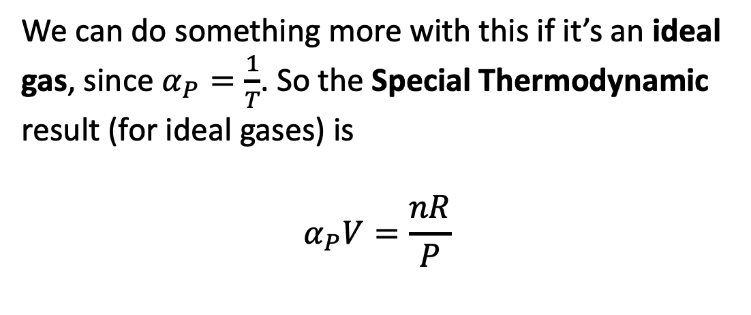
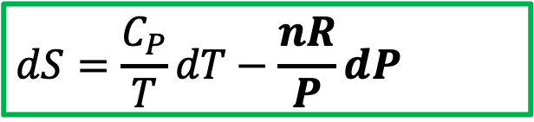
Next: special thermodynamics result for ${\left(\frac{∂S}{∂P}\right)}_{T}$when it’s an ideal gas
We can do something more with this if it’s an ideal gas, since $α_{P}=\frac{1}{T}$. So the Special Thermodynamic result (for ideal gases) is
$$α_{P}V=\frac{nR}{P}$$
$${\left(\frac{∂S}{∂P}\right)}_{T}$$
$${\left(\frac{∂S}{∂T}\right)}_{P}$$
$$dS=\frac{C_{P}}{T}dT−\frac{nR}{P}dP$$
Special Thermodynamics (ideal gas)

Slide 8
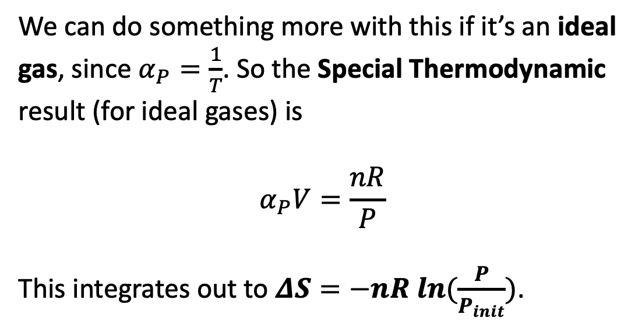
Next: special thermodynamics result for ${\left(\frac{∂S}{∂P}\right)}_{T}$when it’s an ideal gas
We can do something more with this if it’s an ideal gas, since $α_{P}=\frac{1}{T}$. So the Special Thermodynamic result (for ideal gases) is
$$α_{P}V=\frac{nR}{P}$$
This integrates out to $ΔS=−nR ln⁡(\frac{P}{P_{init}})$.
$${\left(\frac{∂S}{∂P}\right)}_{T}$$
$${\left(\frac{∂S}{∂T}\right)}_{P}$$
You should probably commit this to memory too
$$dS=\frac{C_{P}}{T}dT−\frac{nR}{P}dP$$
Special Thermodynamics (ideal gas)

Slide 9


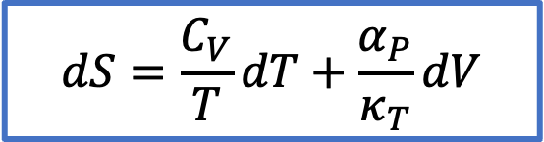



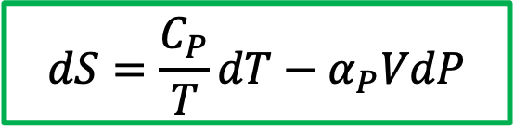

Summary: General Thermodynamics results for $S\left(T,V\right)$ and $S\left(T,P\right)$
$$S(T,V)$$
$$\frac{C_{V}}{T}$$
$$dS=\frac{C_{V}}{T}dT+\frac{α_{P}}{κ_{T}}dV$$
Differential equation of state in $T,V$ space
$$\frac{α_{P}}{κ_{T}}$$
$$\frac{dq_{rev}}{T}=dS$$
Thermodynamic definition of entropy
$$\frac{C_{P}}{T}$$
$$S(T,P)$$
$$dS=\frac{C_{P}}{T}dT−α_{P}VdP$$
Differential equation of state in $T,P$ space
$$−α_{P}V$$

Slide 10
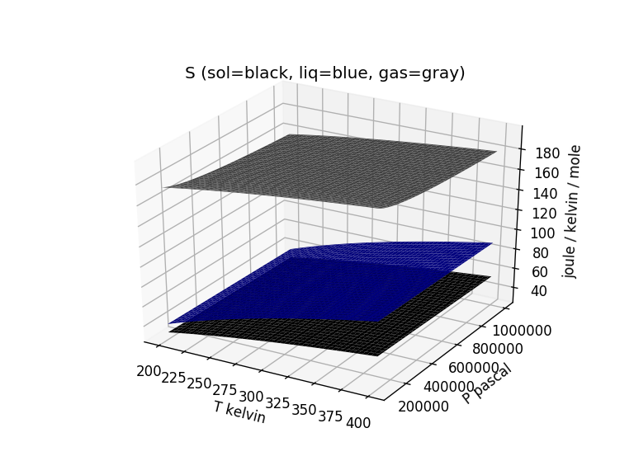
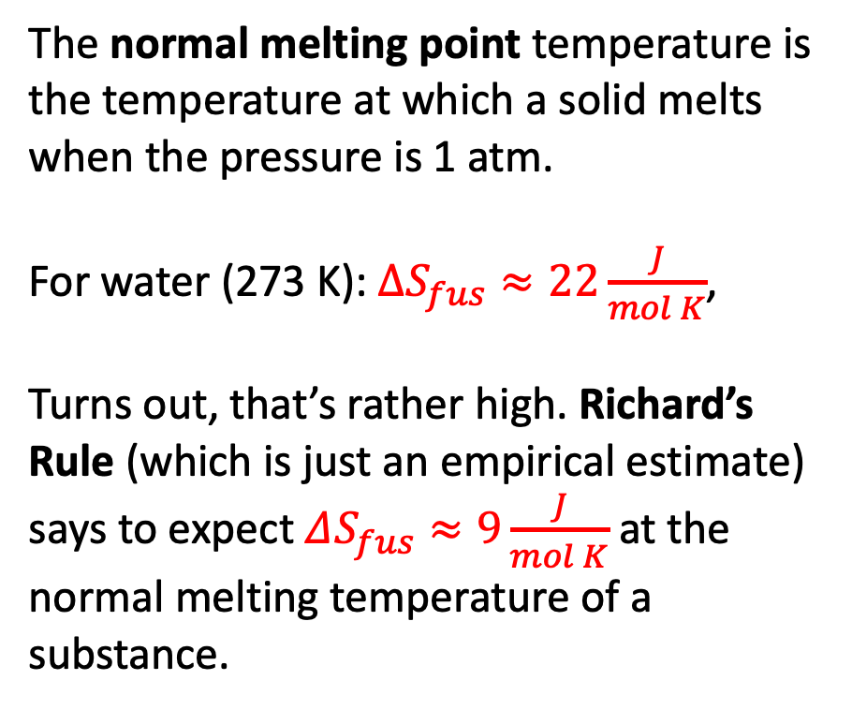
Entropy of fusion: Richard’s Rule
The normal melting point temperature is the temperature at which a solid melts when the pressure is 1 atm.
For water (273 K): $∆S_{fus}≈22\frac{J}{mol K}$,
Turns out, that’s rather high. Richard’s Rule (which is just an empirical estimate) says to expect $ΔS_{fus}≈9\frac{J}{mol K}$ at the normal melting temperature of a substance.

Slide 11
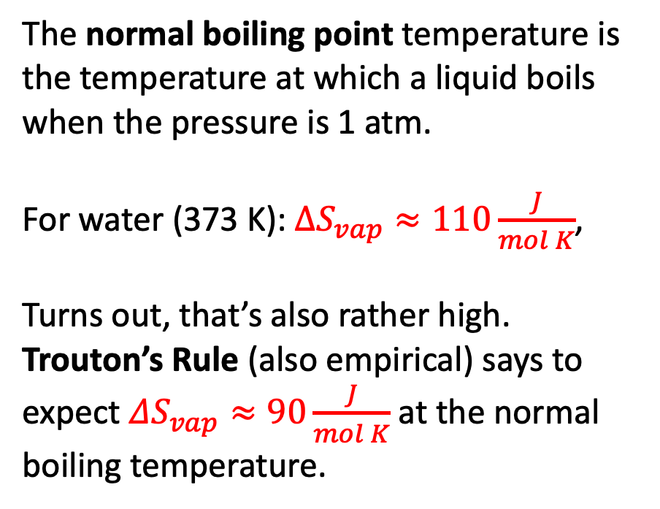
Entropy of vaporization: Trouton’s Rule
The normal boiling point temperature is the temperature at which a liquid boils when the pressure is 1 atm.
For water (373 K): $∆S_{vap}≈110\frac{J}{mol K}$,
Turns out, that’s also rather high. Trouton’s Rule (also empirical) says to expect $ΔS_{vap}≈90\frac{J}{mol K}$ at the normal boiling temperature.

Slide 12
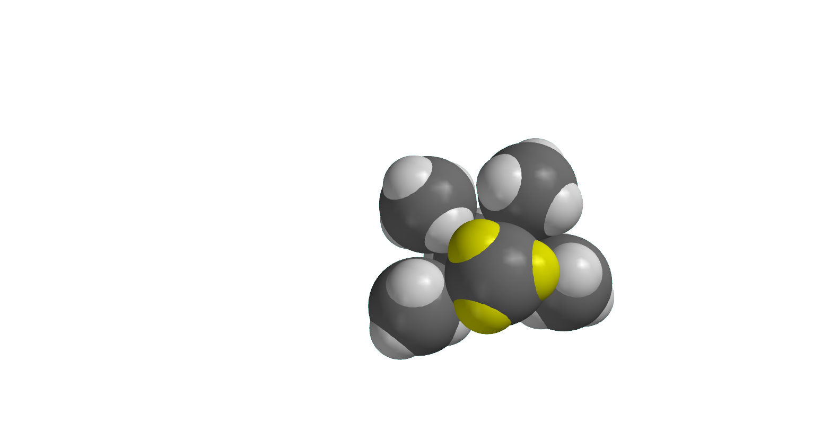
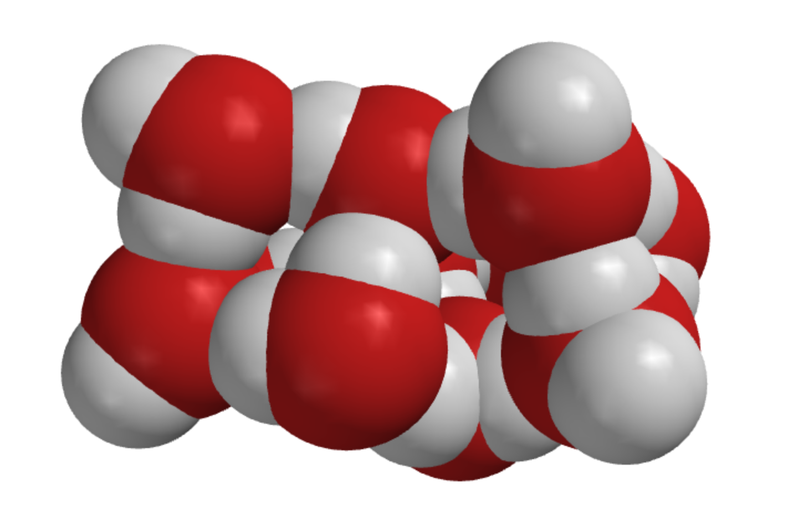
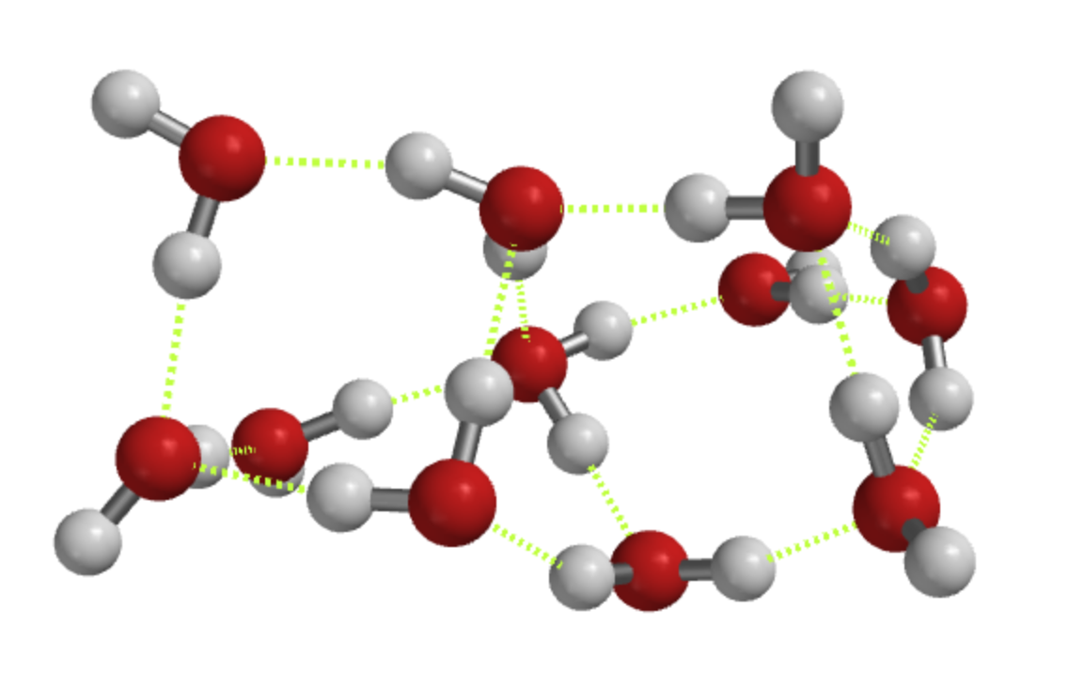
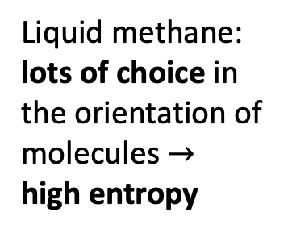
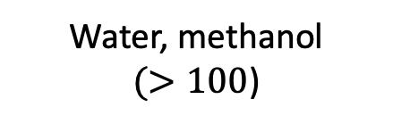
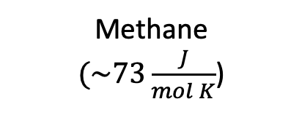
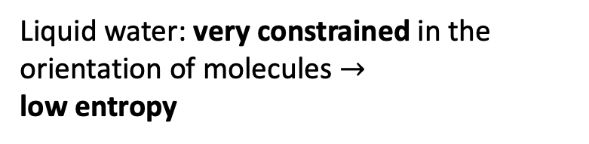
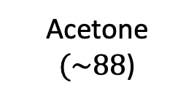
Why $∆S_{vap}$ of water is so big
Methane
$(\sim 73\frac{J}{mol K}$)
Acetone
$(\sim 88$)
Water, methanol
$(>100$)
Liquid water: very constrained in the orientation of molecules $→$
low entropy
Liquid methane: lots of choice in the orientation of molecules $→$
high entropy
Notes:
https://slideplayer.com/slide/7362502/

Slide 13
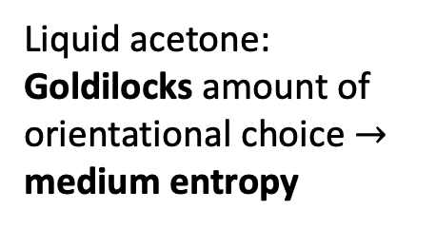
Why $∆S_{vap}$ of water is so big
Methane
$(\sim 73\frac{J}{mol K}$)
Acetone
$(\sim 88$)
Water, methanol
$(>100$)
Liquid water: very constrained in the orientation of molecules $→$
low entropy
Liquid methane: lots of choice in the orientation of molecules $→$
high entropy
Liquid acetone: Goldilocks amount of orientational choice $→$
medium entropy
Notes:
https://slideplayer.com/slide/7362502/

Slide 14
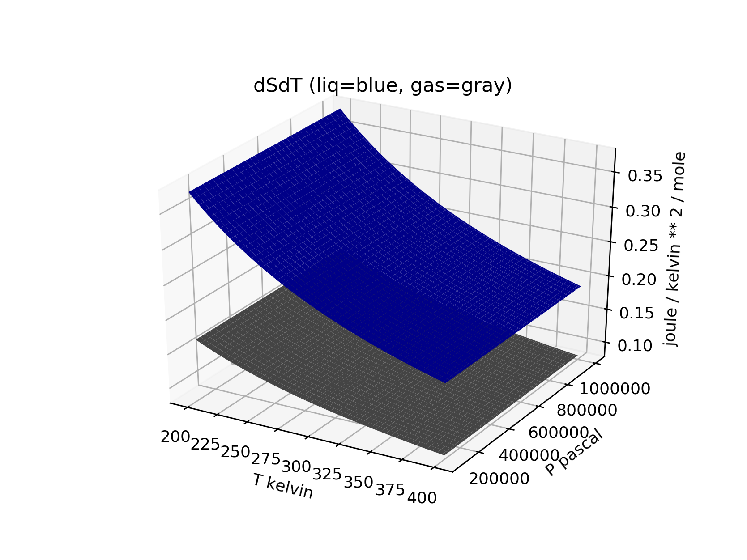
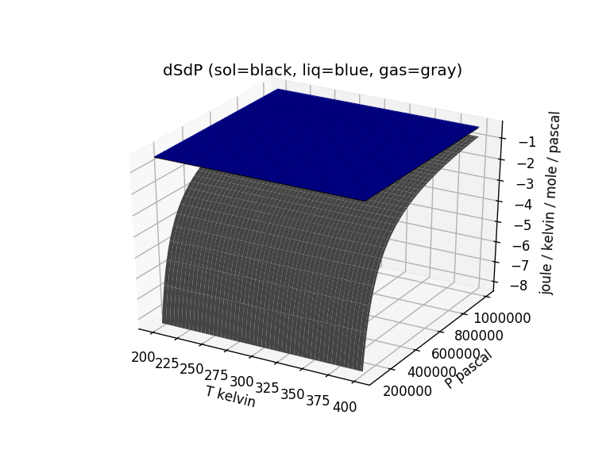
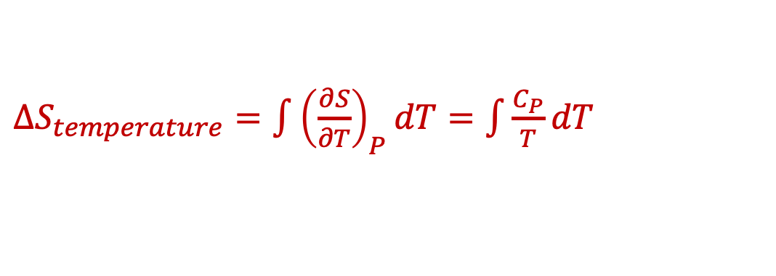
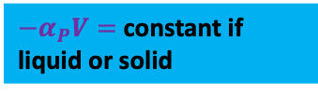





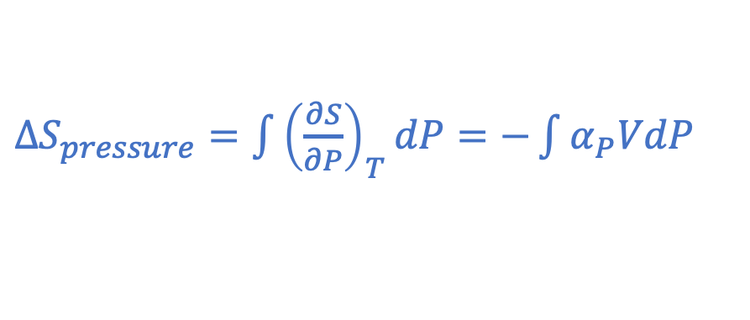

VisualizingSTP focuses on $S(T,P)$ and $∆S_{trs}(T,P)$
${−α}_{P}V=$constant if liquid or solid
$\frac{C_{P}}{T}$
${−α}_{P}V= −\frac{R}{P}$ if a gas
$${−α}_{P}V$$
$∆S_{temperature}=\int{{\left(\frac{∂S}{∂T}\right)}_{P}dT}=\int{\frac{C_{P}}{T}dT}$
$∆S_{pressure}=\int{{\left(\frac{∂S}{∂P}\right)}_{T}dP}=−\int{α_{P}VdP}$
$${\left(\frac{∂S}{∂P}\right)}_{T}$$
$${\left(\frac{∂S}{∂T}\right)}_{P}$$
$$S=S_{f}^{o}+ ∆S_{temperature}+∆S_{pressure}$$

Slide 15
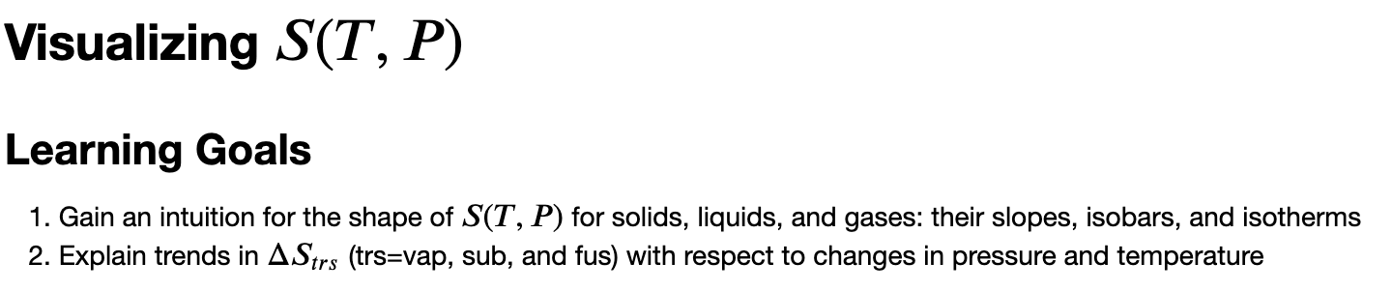
OK, let’s get started

